Slide 1


Sickle Cell Disease
Annual Presentation
October 7, 2026
Jennifer Colozza, PharmD
Clinical Pharmacist
MO HealthNet

Slide 2
RSMo 208.184
During at least one regularly scheduled meeting each calendar year, the advisory council on rare diseases and personalized medicine … shall dedicate time to:
Discuss and evaluate whether the available covered medications, treatments, and services are adequate to meet the needs of MO HealthNet beneficiaries with a diagnosis of sickle cell disease
Review information on treatments for sickle cell disease in late-stage studies that show promise in peer-reviewed medical literature
Review the importance of provider education on the disproportionate impact of sickle cell disease on specific minority populations
References:
Missouri Revisor of Statutes - Revised Statutes of Missouri, RSMo Section 208.184

Slide 3
Prevalence of Sickle Cell Disease
Affects approximately 100,000 people in the US
  > 90% are non-Hispanic Black or African American
  1 out of every 365 Black or African American births
  1 out of every 13 Black or African American babies is born with sickle cell trait (inheritance of a sickle cell gene from only one parent)
Estimated life expectancy is more than 20 years shorter than the average expected in the United States
Estimated that Missouri has 1,900 residents with SCD
70% of children with SCD are enrolled in Medicaid
References:
Centers for Disease Control and Prevention. Sickle Cell Disease. Data & Statistics on Sickle Cell Disease. Data and Statistics on Sickle Cell Disease | Sickle Cell Disease (SCD) | CDC. Accessed 8/12/2026.
USA D. (2023). Data USA: Missouri.

Slide 4
MO HealthNet SCD Population
Included those with diagnosis of SCD in CY 2022 - 2025
Divided into 3 Age Groups based on age at end of CY:
  Pediatric = < 16 years old
  Transition = ≥ 16 and < 25 years old
  Adult = ≥ 25 years old
Data Accessed on 7/28/2026.
All data is based on paid MO HealthNet claims through 12/31/2025 based on Date of Service.

Slide 5
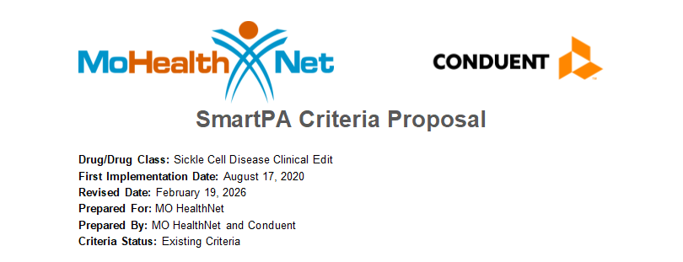
Disease Modifying Drug Therapies
MO HealthNet Criteria
https://dss.mo.gov/mhd/pharmacy-clinical-edits-pdl

Slide 6
Disease Modifying Drug Therapies
Hydroxyurea
(Hyrea, Siklos, Xromi)
Age: All ages, including infants
Dosing: Oral once daily
Mechanism of Action: Prompts the body to produce Fetal Hemoglobin (HbF), preventing sickling.
Clinical Value:
First-line foundational oral therapy
Significantly reduces VOCs and prolongs survival
L-glutamine
(Endari)
Age: 5 years and older
Dosing: Oral powder twice daily
Mechanism of Action: Acts as an antioxidant to reduce oxidative stress and fragility in red blood cells.
Clinical Value:
Reduced acute pain episodes
Primarily used as add-on therapy to hydroxyurea
Crizanlizumab
(Adakveo)
Age: 16 years and older
Dosing: IV every 4 weeks (after initial loading doses)
Mechanism of Action: Monoclonal antibody targeting P-selectin, reducing cellular and vessel adhesion.
Clinical Value:
Reduced acute pain episodes
European approval withdrawn in 2023
Confirmatory STAND trial in the US failed to show a significant benefit over placebo

Slide 7
Oxbryta® (voxelotor)
Allosteric modifier of HbS that increases oxygen affinity, decreasing the concentration of deoxygenated sickle hemoglobin
FDA approved in 2019 under accelerated approval for the treatment of sickle cell disease in patients 12 years of age or older. Accelerated approval was based on increase in hemoglobin concentrations. The indication expanded in 2021 to patients 4 years of age or older.
In Sept 2024, Pfizer withdrew all lots of Oxbryta from all markets and discontinued all active clinical trials and expanded access programs.
Pfizer stated that clinical data indicates the overall benefit of therapy no longer outweighs the risks, with data showing an imbalance in VOCs and fatal events.
In an official statement in August 2026, Pfizer confirmed that after analyzing the final post-marketing safety data and consulting with the FDA, there is no viable path to bring Oxbryta back to the market.
References:
Pfizer Voluntarily Withdraws All Lots of Sickle Cell Disease Treatment OXBRYTA® (voxelotor) From Worldwide Markets. Pfizer Press Release. 9/25/2024.
Pfizer Official Statement, Dear Sickle Cell Community, 8/4/2026.

Slide 8
Utilization of SCD Disease Modifying Therapies
Assessed utilization of Hydroxyurea, Endari, and Adakveo in MHD SCD population at an overall ingredient level in CY 2025
No significant changes from CY 2024 reporting
Data Accessed on 7/29/2026.
All data is based on paid MO HealthNet claims through 12/31/2025 based on Date of Service.

Slide 9
Utilization of SCD Disease Modifying Therapies by Agent
Assessed utilization of each ingredient per participant
Adakveo is only approved for those ≥ 16 years, so no pediatric use is expected.
Slight increase in pediatric utilization of Hydroxyurea
  CY 2025 – 46.39%
  CY 2024 – 43.06%
  CY 2023 – 37.95%
  CY 2022 – 39.41%
Data Accessed on 7/29/2026.
All data is based on paid MO HealthNet claims through 12/31/2025 based on Date of Service.

Slide 10
Curative Therapies:
Hematopoietic Stem Cell Transplantation (HSCT)
Complete replacement of the patient's hematopoietic system with donor cells
Matched Sibling Donor (MSD)
  Limited to the 15 - 20% of patients with an HLA-matched sibling.
  Observational studies have demonstrated overall survival of ≥ 95%
Haploidentical (Half-Match)
  Related donors (typically siblings, children, or parents, but also second- or third-degree relatives) who share at least one haplotype (50% of their HLA loci) with the recipient
  Expands eligibility to > 90% of patients and is the most promising alternative approach
Key Risks: Chronic Graft-versus-Host Disease (GVHD), graft rejection, and mandatory immunosuppression.
References:
UpToDate. Curative therapies in sickle cell disease including hematopoietic stem cell transplantation and gene therapy. Last updated 8/10/2026. Accessed 8/27/2026.

Slide 11
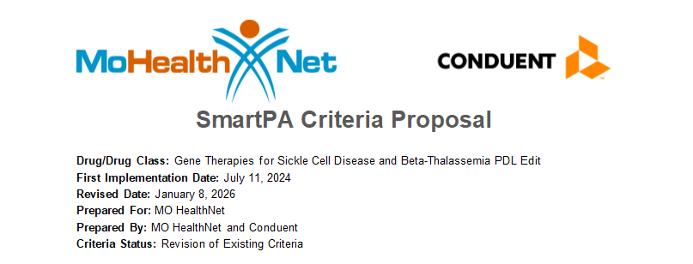
Potentially Curative or Transformative Therapies:
Gene Therapy and Gene Editing
MO HealthNet Criteria
https://dss.mo.gov/mhd/pharmacy-clinical-edits-pdl

Slide 12
Potentially Curative or Transformative Therapies:
Gene Therapy and Gene Editing
Casgevy® (exagamglogene autotemcel)
  Autologous, ex vivo CRISPR/Cas9 gene-editing therapy that edits a patient’s own hematopoietic stem cells to induce expression of high levels of fetal hemoglobin (HbF) in red blood cells
  Initially approved for ages 12 and up but received expanded the approval in July 2026 to patients aged 2 years and older.
Lyfgenia® (Lovotibeglogene autotemcel)
  Utilizes the BB305 lentiviral vector to encode a functional copy of the human βA-T87Q-globin gene into autologous HSCs, which then produce anti-sickling hemoglobin, HbAT87Q, reducing the proportion of HbS in circulating hemoglobin
  Currently approved for patients aged 12 years and older
References:
UpToDate. Curative therapies in sickle cell disease including hematopoietic stem cell transplantation and gene therapy. Last updated 8/10/2025. Accessed 8/26/2026.

Slide 13
Clinical Selection: HSCT vs. Gene Therapy
Matched Sibling HSCT (allo-HSCT)
  Gold Standard
  Pros: Decades of safety data, cure rates > 90%, highly cost-effective (~$1.15M lifetime cost)
  Cons: Requires healthy, HLA-matched sibling donor (only 15-20% of patients have one), chronic risk of GVHD
Autologous Gene Therapy (Casgevy/Lyfgenia)
  Pros: Patient is their own donor; 100% availability; Zero GVHD risk
  Cons: Extremely high upfront cost ($2.2M - $3.1M); myeloablative busulfan conditioning risks (infertility) and incompletely understood risk of myeloid malignancy.
References:
UpToDate. Curative therapies in sickle cell disease including hematopoietic stem cell transplantation and gene therapy. Last updated 8/10/2025. Accessed 8/26/2026.

Slide 14
CMMI Cell and Gene Therapy Access Model
Aims to improve the lives of people living with rare and severe diseases by increasing access to potentially transformative treatments
A multi-year, voluntary CMS initiative designed to help state Medicaid programs pay for high-cost, curative gene therapies while ensuring robust clinical outcomes.
Initial focus on Sickle Cell Disease
References:
CGT (Cell and Gene Therapy Access) Model. CGT (Cell and Gene Therapy Access) Model | CMS. Accessed 8/26/2026.

Slide 15
CMMI CGT Potential Impact
Medicaid participants have uniform access across States that have adopted the model
Medicaid participants undergoing SCD CGT treatment can have fertility preservation paid for by the manufacturer
States get valuable experience in operating outcomes/value-based contracts with the help of CMS
CMS and States get experience negotiating with manufacturers as a block, instead of 50+ individual negotiations, outcomes, and policies
References:
CGT (Cell and Gene Therapy Access) Model. CGT (Cell and Gene Therapy Access) Model | CMS. Accessed 8/26/2026.

Slide 16
CMMI CGT Important Dates
Missouri was the first State Medicaid Program to join and start participating in the model!
  Start Date 3/1/2025
  First MO HealthNet participant dosed under the model in Spring 2025, with another participant in Spring 2026.
  Currently, there are 3 active treatment centers in Missouri and at least 5 other active treatment centers across adjoining states that are qualified to administer one of these transformative therapies.
Currently, 34 state Medicaid programs (32 states, along with the District of Columbia and Puerto Rico), representing 84% of Medicaid beneficiaries with SCD, are participating in the model
Model runs through doses administered through 12/31/2030
References:
CGT Access Model Frequently Asked Questions. CGT Access Model Frequently Asked Questions | CMS. Accessed 8/26/2026.

Slide 17
SCD Therapy Timeline
1910 – SCD first reported
1984 – First successful bone marrow transplant cure
1998 – Hydroxyurea becomes first drug approved for SCD
2006 – Universal newborn screening in all 50 states
2017 – Endari approved
2019 – Adakveo and Oxbryta approved
2023 – Casgevy and Lyfgenia approved
2024 – Oxbryta voluntarily pulled from the market
2025 – CMMI CGT Therapy Model begins targeting SCD
2026 – Casgevy approval expanded to 2 years of age and older

Slide 18
Pipeline Therapies for SCD: Pyruvate Kinase Activators
Increase affinity of hemoglobin in sickled cells for oxygen
Oral therapy - will be appealing to patients and easier to access than IV options
Mitapivat
  Anticipated FDA approval: 11/1/2026
  Already FDA approved in 2022 for pyruvate kinase deficiency (Pyrukynd®) and in 2025 for beta-thalassemia (Aqvesme™)
  Phase 3 results indicate that one primary endpoint was met (hemoglobin response) while the other was missed (pain crises)
FT-4202 (Etavopivat)
  Anticipated filing with the FDA in 2H 2026, leading to a potential launch in 2027
  Phase 2/3 clinical trial results show both primary outcome measures, hemoglobin response rate at Week 24 (>1 g/dL increase from baseline) and annualized VOC rate at 52 weeks, were met
  Estimated primary completion date of Phase 3 trial is August 2027
References:
IPD Analytics. Hematology: Sickle Cell Disease. Accessed 8/27/2026.

Slide 19
Pipeline Therapies for SCD: Other Mechanisms
Wayrilz™ (rilzabrutinib)
  Oral, reversible Bruton’s tyrosine kinase (BTK) inhibitor that works through multi-immune modulation to reduce VOCs associated with inflammation in SCD
  If approved, may be used in patients with SCD who experience severe pain from recurrent VOCs
  Based on clinical trial timeline, approval is unlikely before 2028
CSL889 (hemopexin)
  Human plasma-derived hemopexin that may reduce heme toxicity and restore blood circulation, helping manage acute VOCs in SCD patients
  If approved, may be used as an adjunctive treatment alongside parenteral opioids during an acute VOC
  Based on the clinical trial timeline, approval is unlikely before 2028.
References:
IPD Analytics. Hematology: Sickle Cell Disease. Accessed 8/27/2026.

Slide 20
Pipeline Therapies for SCD: Gene Therapies
Risto-cel (Ristoglogene Autogetemcel)
  Investigational (Phase 1/2 clinical development)
  While Casgevy utilizes standard CRISPR-Cas9 to induce double-strand DNA breaks that disrupt the erythroid enhancer of the BCL11A gene, risto-cel leverages a precise adenine base editor to perform a single A-to-G nucleotide transition directly in the proximal HBG1/HBG2 promoters. By mimicking protective, naturally occurring hereditary persistence of fetal hemoglobin (HPFH) mutations, risto-cel avoids double-strand cleavage and its associated genomic instability while clinically driving superior, more uniform fetal hemoglobin induction.
  Generates the highest mean HbF levels in clinical trials (~60%)
  Planned submission of BLA to the FDA as early as the end of 2026
  Given standard review timelines, a potential FDA approval is not anticipated before 2028
References:
IPD Analytics. Hematology: Sickle Cell Disease. Accessed 8/27/2026.
Hanna et al., "Base Editing of HBG1 and HBG2 Promoters for Sickle Cell Disease," New England Journal of Medicine, April 2026
Beam Therapeutics, BEACON Phase 1/2 Trial Interim Analysis (NCT05456880)
FDA RMAT and Orphan Drug Designation Files, 2025

Slide 21

Conclusion
The following are available for review and comment:
  The Sickle Cell Disease Clinical Edit Proposal
  Gene Therapies for Sickle Cell Disease and Thalassemia PDL Edit Proposal
Any questions?

